Slide 1


Slide 2


ODYSSEY
TRAVEL
AGENCY
“ Transform Travel Planning: Introducing Our Web-Based Solution “

Slide 3
Because money returns, time doesn't.

Slide 4


Our Vision
At Oddesey Travel Agency, we envision a world where every journey is an opportunity for personal growth, cultural exchange, and unforgettable moments. With a commitment to authenticity, sustainability, and innovation, we curate meaningful experiences that leave a lasting impact on travellers and the communities they visit. Join us as we redefine the way people experience travel. Welcome to a world of possibilities with Oddesey Travel Agency.
3

Slide 5

Let’s Explore

Slide 6
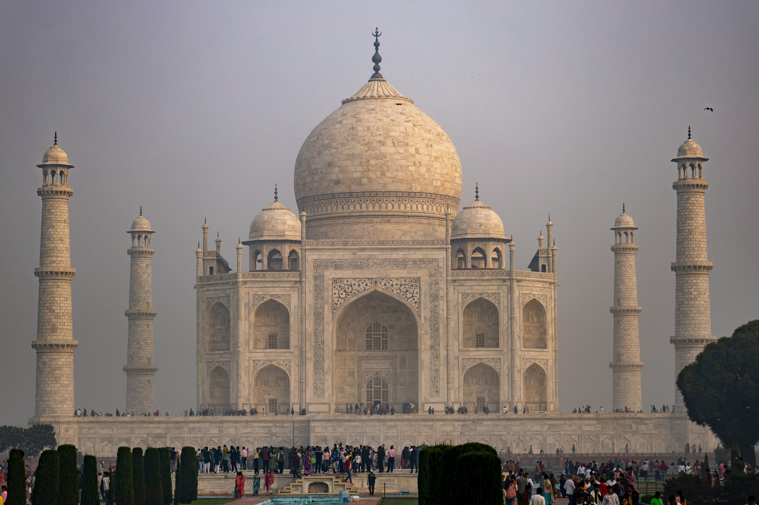

Project features
Plan Exploration
Customization Options
Flight Booking
User Profiles

Slide 7

Project features
Payment Gateway
Reviews and Ratings
Admin Panel
User Panel

Slide 8
Project PLAN
PHASE | DURATION | Description
Phase 1: Planning and Preparation | 1 month | Project Initiation Requirement Gathering Resource Allocation
Phase 2: Design and Development | 4 months | UI/UX Design Database Design Backend Development Frontend Development Integration
Phase 3: Testing and Quality Assurance | 1 month | Unit Testing Integration Testing User Acceptance Testing (UAT)
Phase 4: Deployment and Launch | 1 month | Deployment Training Soft Launch

Slide 9
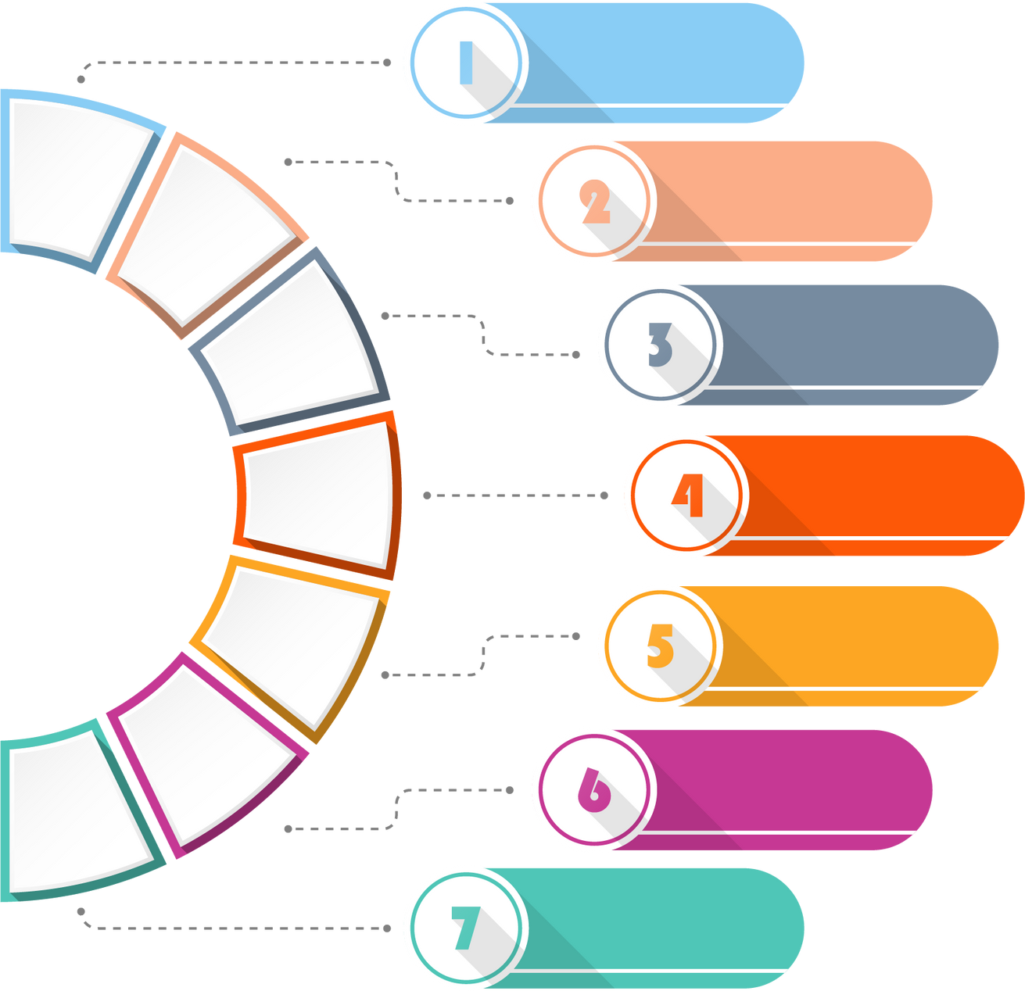

Bug Fixing and Optimization
Post-Launch Support and Maintenance
Feature Enhancements
Bug Fixing and Optimization
Technical Support
User Feedback Integration
Continuous Improvement
Documentation and Training

Slide 10
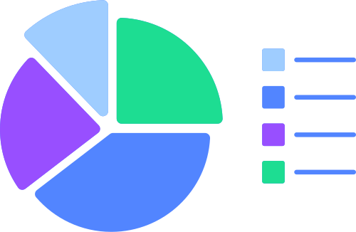
Budget Analysis
$ 45,000
Design Expenses
$ 55,000
Development Costs
$ 60,000
Quality Assurance
Database Hosting
$ 2,70,000

Slide 11


technologies & tools
Next.js
MySQL
Tailwind
CSS
Figma
Firebase
VS Code
Git and GitHub
Node.js
Express.js
Postman

Slide 12

Background
In today's tech-driven travel landscape, travelers crave seamless and personalized experiences. Traditional planning methods are cumbersome and lack flexibility.
Our solution? A centralized platform offering package exploration, customization, flight booking, and secure payments. By addressing these pain points, we elevate the booking experience. With COVID-19 reshaping travel norms, safety and flexibility are paramount. Our platform ensures transparent info, flexible bookings, and seamless payments, fostering trust. Ultimately, our goal is to revolutionize travel planning by providing convenience, accessibility, and satisfaction, establishing us as a leader in the industry.

Slide 13



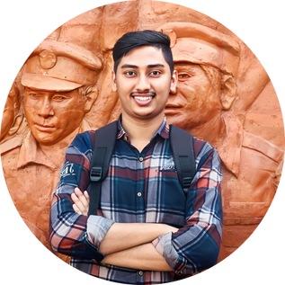

our team
Arnab shikder
mohammad asmual hoque yousha
software engineer & cto
performance testing engineer & cms
sayed hossain
mohammad hafizur rahman sakib
analyzer & research
manager & backend engineer
mohammad ohidul alam
frontend engineer & ui / ux designer

Slide 14
Thank You

